Slide 1
M04 L26 Traverse Binary Trees and Recursion

Slide 2

Today
Check in
Project Iteration 02
Lab Solution M04 L22 lab_solution
Goals
Understand process for traversing binary trees and recusion

Slide 3
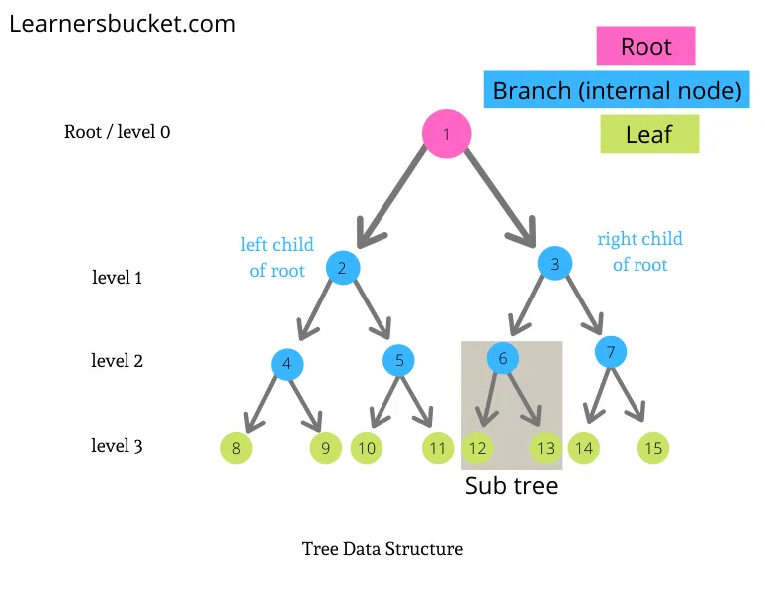
Binary Tree
In a binary each node contains two references (pointers or links) and contains
root node is the first node in a tree and has no parent.
Each link in the root node refers to a child.
left child is the first node in the left subtree where nodes reached through left reference (pointer) link
right child is the first node in the right subtree where odes reached through right reference (pointer) link
The children of a node are called siblings.
A node with no children is called a leaf node.
Height is the longest possible path in a tree, from root to most distant node
binary trees

Slide 4
Insert
Copy this code Tree Insert non recursive and paste it in Online Java Compiler, Visual Debugger, and AI Tutor - Learn Java programming by visualizing code
Notice how information is stored in memory.
Did you approach it this way?
Would there be a better way to implement the insertion?

Slide 5
Using Recursion with Trees
Why recursion works well with trees:
Trees are recursive data structures — each node is a subtree
Recursion mirrors the structure and logic of the tree
It reduces the need for tracking parent pointers or using loops

Slide 6
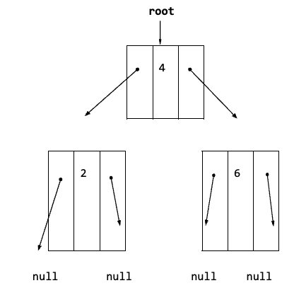
Recursive Insert
When might it be better to not use recursion?
A binary search tree (BST) is recursive in structure — each node is the root of its own subtree.
Copy this code Tree Insert recursive and paste it in Online Java Compiler, Visual Debugger, and AI Tutor - Learn Java programming by visualizing code
Discuss public boolean insert(int value)
Why public?
This is a wrapper that checks if the tree is empty.
If it's not, it calls the helper method starting from the root.
Discuss private boolean insertRecursive(TreeNode current, int value)
Why private?
Think of the method like a postman walking down a tree:
At each house (node), they check the number (value).
If it's smaller, they go left. If larger, go right.
If the spot is empty, they drop off the new “package” (node) and stop.

Slide 7
Purpose of a Wrapper
Think of the wrapper like the front door to a building. When someone walks in (calls insert(5)), the front desk (wrapper) checks if the building is empty. If not, they send the person to the right department (call the recursive helper).
It handles the special case when the tree is empty (root == null)
It provides a simple method signature
You just call insert(5)
You don’t have to say insertRecursive(root, 5) every time
It protects internal implementation — insertRecursive() is private and only used inside the class.
Feature | Wrapper Method (insert) | Helper Method (insertRecursive)
Visibility | public | private
Called by | Outside the class (e.g., main) | Only from within the class
Handles | Base case: empty tree | All recursive steps
Benefits | Simpler API, hides complexity | Recursively walks tree to find correct spot

Slide 8
Search
// Searches binary tree for a specific key
public boolean search(int key){
boolean found = false; // Indicates if key is in tree
TreeNode current = root; // Start at the root of the tree
// While the key is not found and end of tree is not reached
while (!found && current != null){
// Move current either to the left or right child node
if (key < current.data){
current = current.left;
} else if (key > current.data){
current = current.right;
} else{
//notice a return doesn't need to be used
found = true;
}
} // while
return found;
} // search
Example of search without recursion.

Slide 9
When to Use Recursion in Binary Search Trees
Use recursion when:
The algorithm naturally divides into subproblems:
Traversals (inorder, preorder, postorder)
Search
Insert
Delete (especially with two children)
You want code that is clean and readable
The tree is not very deep (to avoid stack overflow)
When recursion might be a bad idea:
If the tree is very large and unbalanced, recursion can lead to:
Stack overflow
Performance issues due to deep recursion
In those cases, use iterative methods with loops or stacks

Slide 10
Static Class
Add BinaryTreeTest.java to see the implementation of a recursive search.
Notice the static TreeNode class is nested in the BinarySearchTree class. This is one way to implement the node class following encapsulation and no need for getters and setters.
The TreeNode class is nested inside the BinarySearchTree class. By declaring it static, you’re saying:
This inner class does not need a reference to an instance of the outer BinarySearchTree class.
Relating static to the Math class
The Java Math class is an example of a class that is:
Utility-based
Composed entirely of static methods
And never instantiated
You’ve used the Math class before without ever creating an object from it. That’s because all of its methods are static — they don’t rely on any internal state. That’s the same reason we make a nested class like TreeNode static — it doesn't need access to the outer class and saves us from unnecessary object creation.
class BinarySearchTree
private static class TreeNode{
private int data;
private TreeNode left;
private TreeNode right;
public TreeNode(int data){
this.data = data;
left = null;
right = null;
}
} // TreeNode

Slide 11
Balanced Binary Trees
The binary search tree is not balanced so it has limitations. Why Balance Matters:
In a regular BST, if data is inserted in sorted order, it becomes skewed (like a linked list), making operations slow — O(n) instead of O(log n).
A balanced tree keeps operations like insert, search, and delete efficient — close to O(log n).
A balanced tree is a tree where the height difference between the left and right subtrees of any node is kept small — usually no more than 1 or 2 levels.
Balanced trees prevent the worst-case performance of BSTs.
Java’s TreeMap<K,V> and TreeSet<E> uses Red-Black Trees because they provide a good tradeoff for general-purpose use.

Slide 12
Traversing a Binary Tree
Traversals are classified by the order in which the nodes are visited.
Several ways to traverse a tree:
Depth first
Preorder
Inorder
Postorder
Breath first
Level-order
Recursion simplifies the implementation of tree traversals.
Note: When talking about traversals
Visiting a node means – processing the data within the node

Slide 13
Create and Traverse Binary Search Tree
To create a binary search tree and traverse the tree are recursive.
InsertNode
InOrder
PreOrder
PostOrder
A recursive function is a function that calls itself either directly or indirectly through another function. There must be a base case to stop recursion.
The recursion will continue until a NULL pointer is found.
What are the steps?
What is the base case?

Slide 14

PreOrder Traversal
The root node is visited first, then the left subtree and finally the right subtree.
When you need to visit the roots (parents) before the leaves.
Use to make a duplicate of the tree
public void preorder(){
preorder(root);
System.out.println();
}
private void preorder(TreeNode node){
if (node != null){
System.out.print(node.data + " ");
preorder(node.left);
preorder(node.right);
}
}

Slide 15
InOrder Traversal
The left subtree is visited first, then the root and later the right subtree. Remember that every node may represent a subtree itself.
When you want to flatten the tree into its original sequence
Use to display the values in increasing order
public void inorder(){
inorder(root);
System.out.println();
}
private void inorder(TreeNode node)
{
if (node != null){
inorder(node.left);
System.out.print(node.data + " ");
inorder(node.right);
}
}

Slide 16
PostOrder Traversal
First, traverse the left subtree, then the right subtree and finally the root node.
When you need to visit all the leaves before any nodes
Use to delete from leaf to root – delete a tree
public void postorder(){
postorder(root);
System.out.println();
}
private void postorder(TreeNode node){
if (node != null){
postorder(node.left);
postorder(node.right);
System.out.print(node.data + " ");
}
}

Slide 17
LevelOrder Traversal
First visit the root node, then the next level from left to right.
When you care about the distance from the root
public void levelOrder(){
if (root == null)
return;
Queue<TreeNode> queue = new LinkedList<>();
queue.add(root);
while (!queue.isEmpty()){
TreeNode current = queue.poll();
System.out.print(current.data + " ");
if (current.left != null)
queue.add(current.left);
if (current.right != null)
queue.add(current.right);
}
System.out.println();
}

Slide 18
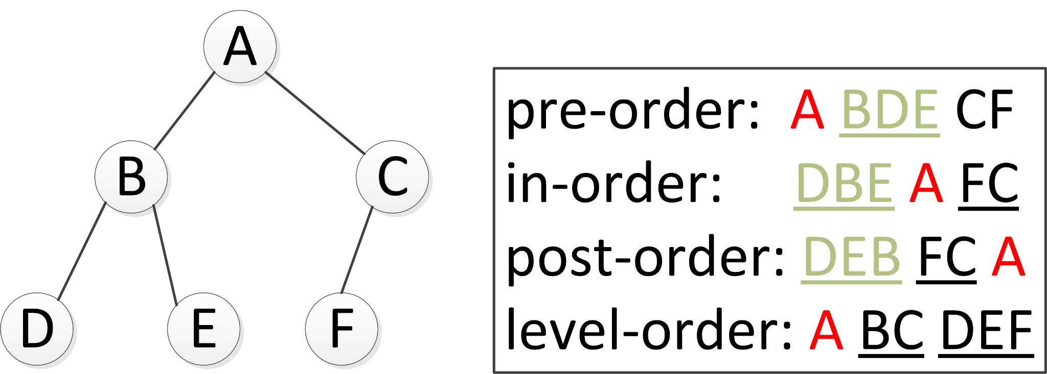
Traverse Trees, TreeMap and TreeSet

Slide 19
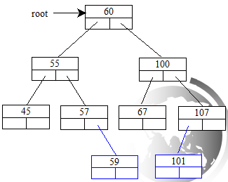
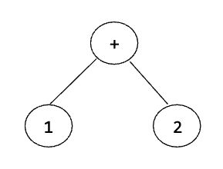
Example
Reminder
Preorder: + 1 2
Inorder: 1 + 2
Postorder: 1 2 +
Preorder: 60 55 45 57 59 100 67 107 101
Inorder: 45 55 57 59 60 67 100 101 107
Postorder: 45 59 57 55 67 101 107 100 60
Level-order: 60 55 100 45 57 67 107 59 101

Slide 20
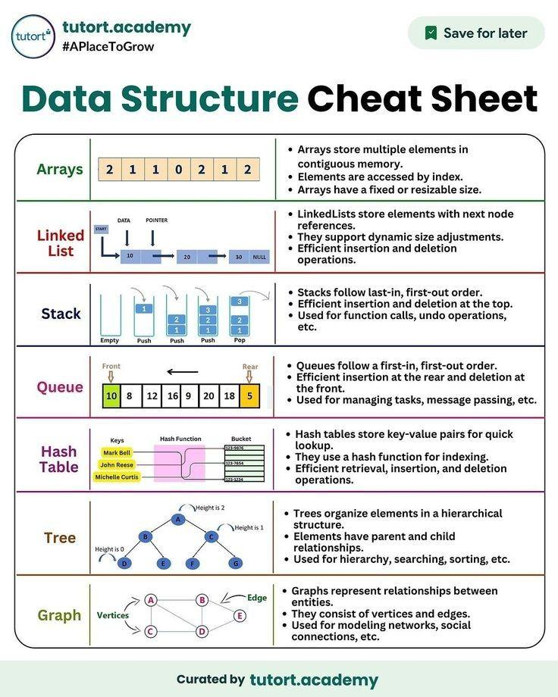
Preparation

